Slide 1

FOOD ITEMS AND OUTLET SALES ANALYSIS
Julian Arroyave-Vergara

Slide 2
PROJECT GOALS:
Finalize the analysis on information collected to describe trends
Present visualizations for a better understanding of the OUTCOMES
EVALUATION OF AVERAGE SALES AND AVERAGE VISIBILITY BASED ON ITEM AND OUTLET TYPE.

Slide 3

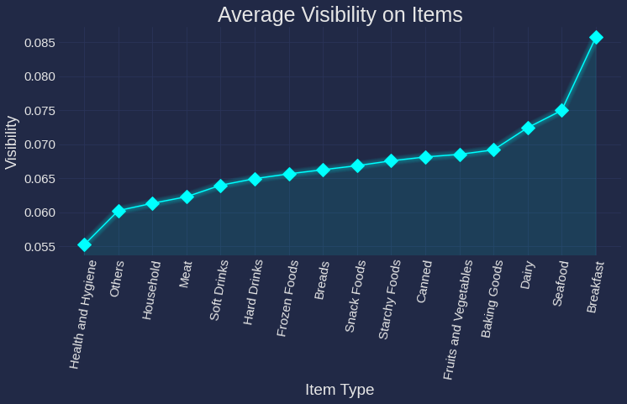
AVERAGE ITEM VISIBILITY
As we can see in the visualization, the average visibility of the Breakfast Items is the higher one of all food items for this data collected.
While the Health and Hygiene falls below 50% being the last one on this list.

Slide 4
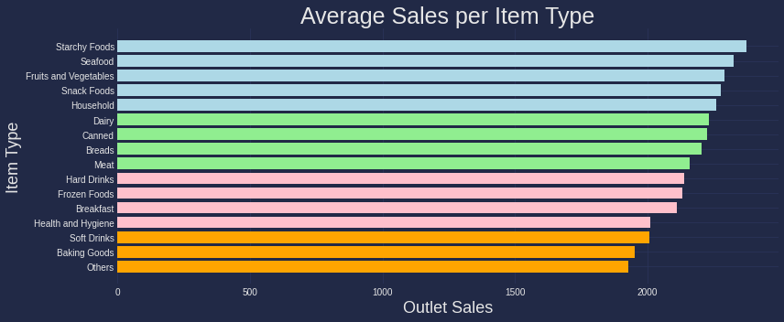
AVERAGE SALES PER ITEM
Here we have an overview of the average sales per item grouped by the outlet sales presented on the data collected.

Slide 5

AVERAGE SALES PER ITEM
From the previous visualization we can conclude the baking goods are the ones with the lower average sales on the outlets, while the starchy foods and the seafood are the one leading the sales.
Even though there are some items that are not performing as good as the top ones, we can observe a tendency to have a very near performance on the sales for each category.

Slide 6

Model for predicting Sales based on Item characteristics
I analyzed a couple of ways to predict the sales of Items based on their characteristics. And while both were a great way to help us understand where we stand, the conclusion is to use the linear regression model, as it gave better results when evaluating its performance.

Slide 7

So, what conclusions can we get from this analysis?
Even though the Breakfast Items have the highest average visibility at the outlet locations, it still doesn’t perform well when it comes to sales. So, it brings up the question: Which better marketing strategies can we use as a company to improve sales? Maybe Promote Bakery Items on sale at the Counter/Cashier stands?
As we could see on slide number 3, The Household items don’t have a high average visibility at the Outlet locations, but this doesn’t affect the sales. The trend and pattern analysis on sale shows a fairly good performance without having to invest a lot on marketing strategies or visibility accommodation.

Slide 8

THANK YOU FOR YOUR ATTENTION.
I hope you have gained an insight into how helpful it is analyzing trends for sales performance and for questioning and transforming marketing strategies.

